Slide 1
UNIT 4:
Ecosystem Approach to Fisheries Management - EAFM

Slide 2

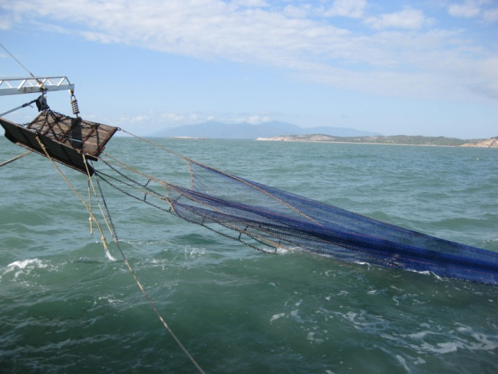
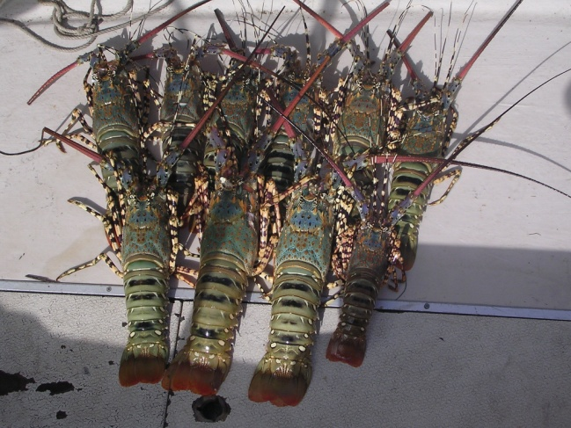
Ecosystem approaches
Activity 4.1: In groups class discuss different types of management approaches used locally. Present back to the class.
Conventional fisheries management
Manages target species/fishery in isolation
Top-down (government) approach

Slide 3
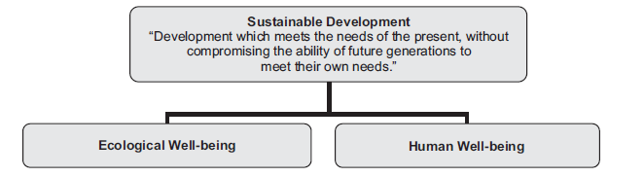
Ecosystem approaches
‘Sustainable development’ (early 1980s)
A balance between ecological well-being and human well-being
  This led to multiple management approaches based on these principles →EAFM was one of these

Slide 4
Defining EAFM
What is EAFM?
The act of fishing impacts not just one target species but often multiple target species and the wider ecosystem. Also, target species are impacted by factors other than fishing (remember Unit 1 – Threats).
EAFM takes this into account by combining conventional management with ecosystem/human management

Slide 5
Defining EAFM
FAO (2005) definition:
“An ecosystem approach to fisheries management is defined as striving to balance diverse societal objectives by taking into account the knowledge and uncertainties about biotic, abiotic and human components of ecosystems and their interactions and applying an integrated approach to fisheries within ecologically meaningful boundaries.“

Slide 6
Defining EAFM
The key FAO principles that EAFM should address are that:
• fisheries should be managed to limit their impact on the ecosystem to an acceptable level;
• ecological relationships between species should be maintained;
• management measures should be compatible across the entire distribution of the resource;
• precaution in decision-making and action is needed because the knowledge on ecosystems is incomplete; and
• governance should ensure both human and ecosystem well-being and equity.
Notes:
*see course notes for further reading.

Slide 7
Defining EAFM
How is EAFM different to conventional management?
EAFM is an extension of conventional management
input and output controls are still used, but
  Scope of management is broadened to encompass multiple species as well as direct AND indirect impacts
  Includes social, economic and ecological issues

Slide 8
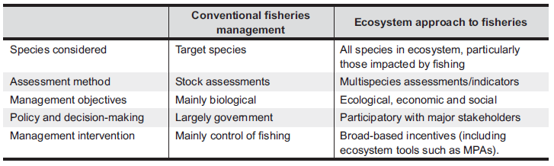
Conventional vs. EAFM

Slide 9
Conventional vs. EAFM
*See Table 4.1 in course notes for an expanded version of this table.

Slide 10
Traditional approaches
Discussion: Refer to Table 4.1 in the course notes and discuss in the context of local marine tenure.
What are some local traditional management methods that have been used? Are they consistent with EAFM? Are there any new/other management methods that EAFM potentially introduces locally?

Slide 11
Other approaches
Ecosystem-based management (EBM)
Key aspects:
integration of ecological, social, economic and cultural goals
considers ecological boundaries (not just political)
uses an adaptive and precautionary approach
engages stakeholder as a collaboration
incorporates ecosystem processes and functioning
combines sustainability of human and ecological systems
integrates across multiple sectors
  EAFM is focused on one sector (fishing)

Slide 12
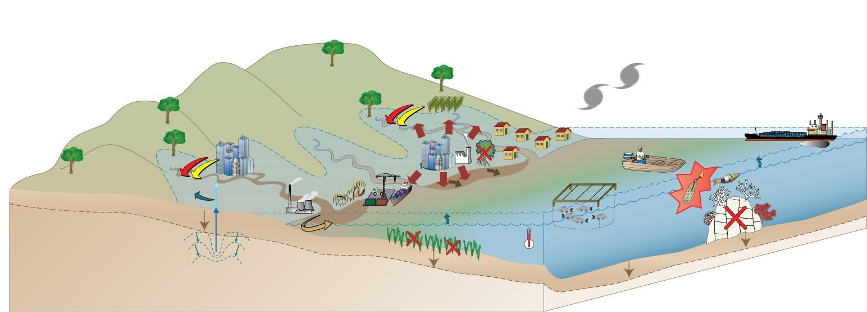
Other approaches
Integrated coastal zone management
This approach integrates across all sectors (like EBM) and considers aquatic and terrestrial, but focuses on the coastal zone (ie. geographically limited)

Slide 13
Other approaches
Co-management
Reversal of conventional management
Bottom-up approach
Negotiated management – controlled by local community

Slide 14
Other approaches
Marine Protected Areas
more a tool than an approach
a tool introduced with ecosystem management
not just “no-take” areas – can be multiple use
IUCN definition:
“A clearly defined geographical space, recognised, dedicated and managed, through legal or other effective means, to achieve the long-term conservation of nature with associated ecosystem services and cultural values.“

Slide 15
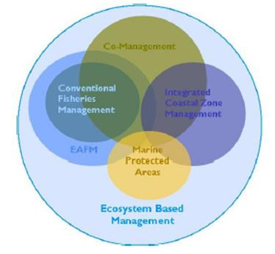
Inter-relationships

Slide 16
Inter-relationships
Summary of key differences among the main management approaches.

Slide 17
Precautionary principle
Precautionary principle (FAO, 2003):
“where there are threats of serious irreversible damage, lack of full scientific certainty shall not be used as a reason for postponing cost-effective measures to prevent environmental degradation.“
More than ever, ecosystem approaches to management require the use of the precautionary principle.
  use the best available knowledge.
  accept that information requirements will be incomplete.
For example, the PNG National Beche-de-mer Management Plan explicitly advocates the use of the precautionary principle saying: “Precautionary Approach” means setting down restrictions to control harvesting in absence of adequate scientific data. These restrictions include setting of TAC, seasonal and area closure and control fishing efforts.

Slide 18
Unit review

Slide 19
EAFM
Activity 3.2: In small groups think about and write down how an EAFM may be applied to a specified local area (your case study) that is consistent with traditional local customs. Report back to class explaining why.
15 minute personal review: unit review, students to review main concepts of unit in the course notes, contribute any new words (new to them) to their own personal glossary in the back of their notebook (local language equivalent terms should also be recorded where possible)

